Slide 1
Optimization of the novel TDCGAN architecture
Andre Nakkab, Hao Tian

Slide 2
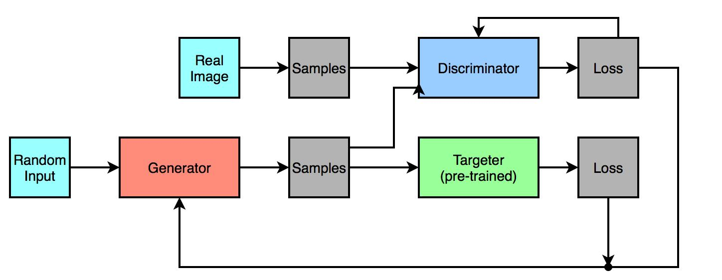
Executive Summary:
This architecture, which we will refer to as the Targeted Generative Adversarial Network (TGAN) utilizes a fully trained image recognition network as a sort of tertiary element in a generative adversarial network.

Slide 3
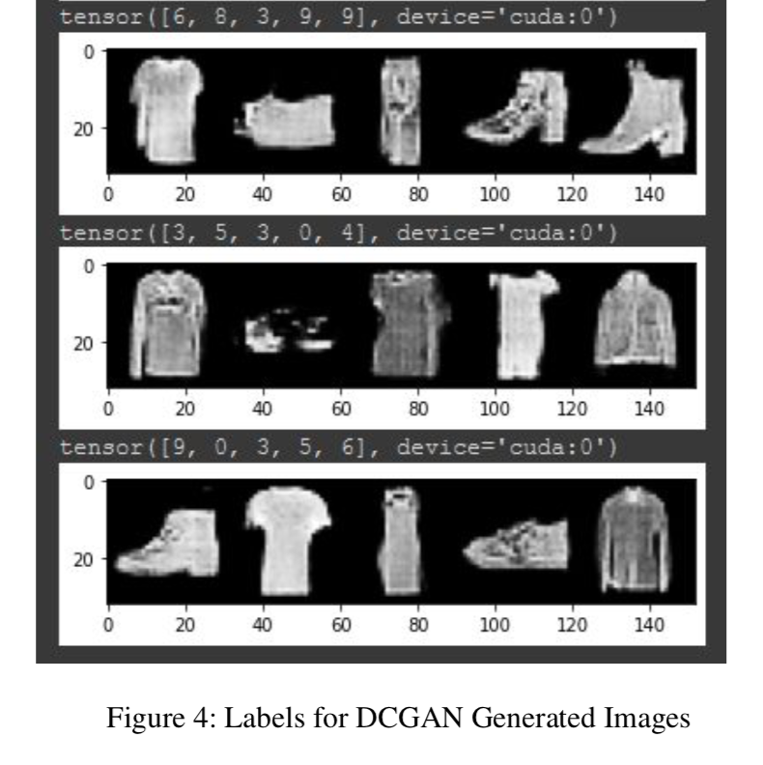
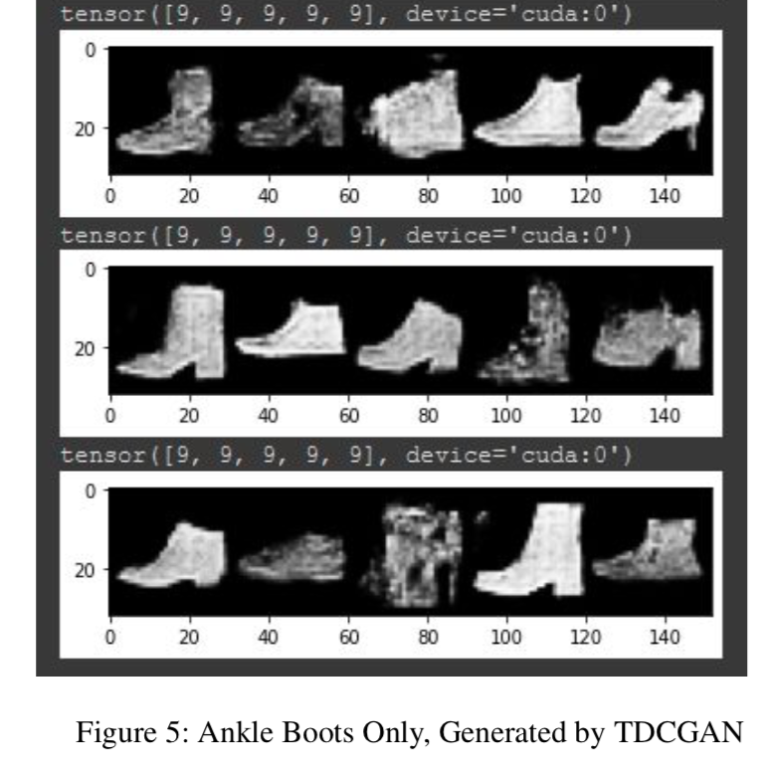
Executive Summary:

Slide 4
Executive Summary:
Novel changes to the TDCGAN for this project:
Switch dataset from FashionMNIST to CIFAR-10.
Implement a ResNet-18 module or similar to improve Targeter / Discriminator performance
Optimize performance, especially needed for more complex dataset

Slide 5
Approach:
In this project, we hope to optimize this architecture utilizing a few primary optimizations:
Use multiple GPUs to accelerate training time
Use multi-threading for improved data load times
Run on Nvidia RTX 8000 GPUs instead of the RTX 2080 TI from the original implementation
Greatly increase batch size while linearly scaling learning rate
Fine-tune hyperparameters for effective performance, even on complex data/images

Slide 6
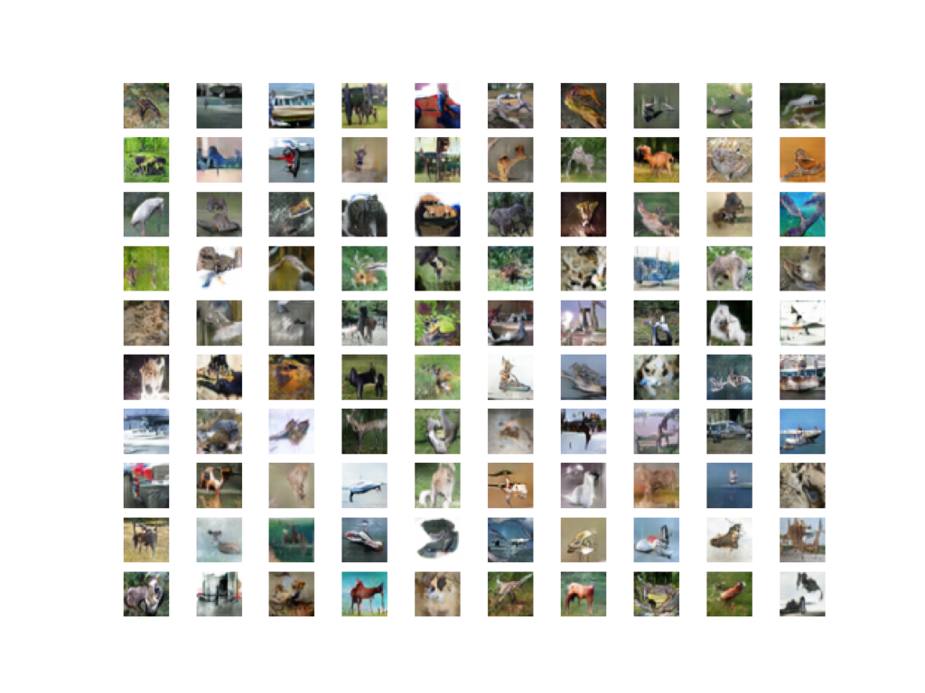
Approach:
GAN generated CIFAR-10 examples after 100 epochs:

Slide 7
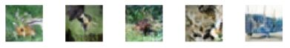
Approach:
GAN generated CIFAR-10 examples after 100 epochs:

Slide 8
Main results:
Overall speed was found to have more than tripled after efficiency optimizations:
Hardware Time (sec) | 1 RTX 2080 TI | 1 RTX 8000 | 2 RTX 8000s
T. Data Load | 592.92 | 607.84 | 41.99
T. Compute | 561.53 | 718.22 | 375.20
T. Train Time | 1586.81 | 1395.12 | 466.24
GAN Data Load | 625.26 | 625.58 | 43.23
D. Train Time | 723.19 | 1403.52 | 885.96
G. Train time | 568.83 | 3374.78 | 1979.76
GAN Total Time | 8472.17 | 8453.02 | 4387.42

Slide 9
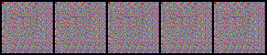
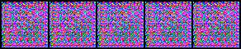
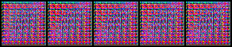

Main results:
TDCGAN generated “trucks” after 50 epochs:

Slide 10
Conclusion:
Requires more training epochs than simpler Fashion MNIST dataset
Begins generating pixel maps which activate proper categorical label on Targeter
Discriminator trains more quickly than Generator due to use of ResNet-18 architecture
More epochs likely necessary for GAN equilibrium
More resources needed to keep training times reasonable

Slide 11
Github link:
https://github.com/ajn313/HPML-Final-Project

Slide 12
References:
Kuang Liu, https://github.com/kuangliu/pytorch-cifar
Jason Brownlee, https://machinelearningmastery.com/how-to-develop-a-generative-adversarial-network-for-a-cifar-10-small-object-photographs-from-scratch/
Andre Nakkab, https://github.com/ajn313/Deep-Learning-Final-Project-Fall2021

